Slide 1

Chama The app course back end test
Lucas Fernandes Rodrigues
https://github.com/rodriguesl3/
https://www.linkedin.com/in/lucasrodriguess/

Slide 2
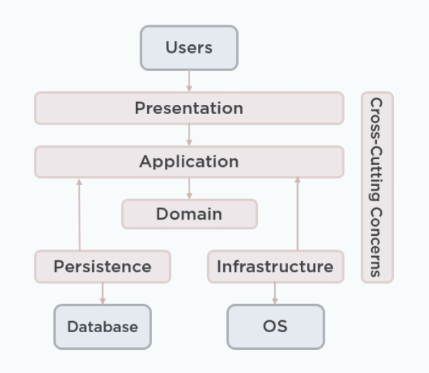
Architecture decisions
I decided to use Clean Architecture to represent each responsibility in one layer, helping the developer to follow the SOLID principles and easy separate responsibilities on the Project.

Slide 3

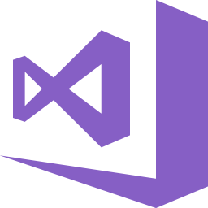

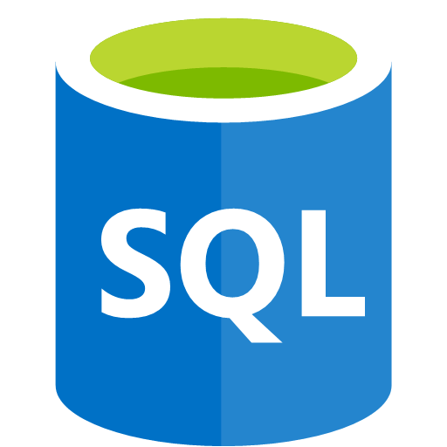
Technologies used
Tools
Decide to use Visual Studio 2017 as IDE to develop the system,
Azure SQL to save all information necessary.
Azure Service Bus to handle the queue and help the system to work asynchronously.
Azure Application Insight to handle the logs of the application
Swagger to consume the endpoints and help it to create a draft documentation to the front end developer.
Frameworks
Asp.Net Core to develop system,
EF Core to connect Database.

Slide 4
Technology use decision
Net Core VS Net Framework: Net Core is easy to scale out and it run cross platform. Meanwhile, Net Framework only run in Windows Platform and it is not integrated natively to Docker Linux Container (thinking in Alpine Docker image)
Azure Service Bus vs Rabbit MQ: Azure Service Bus is quick to publish and don’t need any deeply configuration. Rabbit MQ require configurations of environment, publishment and Types (Exchange, Direct, Fanout, among others)
Azure SQL vs Cosmo DB (Mongo API): Azure SQL because I decide to use EF Core as database connector, despite of the fact that Cosmo DB (Mongo API) works faster according to my experience.
Application Insight vs Log4Net: Application Insight is totally integrated in the Azure environment and it is customizable by the developer. Log4Net is useful to catch exceptions on the system but it does not provide a dashboard portal to easily detect where is the problem.

Slide 5
Steps solution
API
Using ASP.Net Core 2.1 and Swagger to consume the API;
Scaling out
Using Azure Service Bus, basically it will run using the “fire and forget” concept, giving a faster response to the final user.
Querying
To calculate ages in each course, I decide to run it on background, when the message come from Service Bus Queue, this way the system gain performance and data is more trustworthy.

Slide 6
Challenges
As I have never used Azure Service Bus and Azure Application Insight before I needed to read some Microsoft articles in order to learn it.

Slide 7

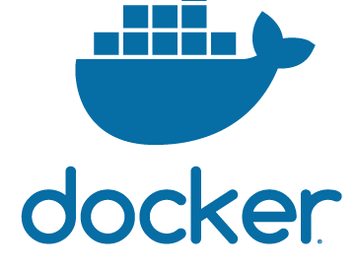
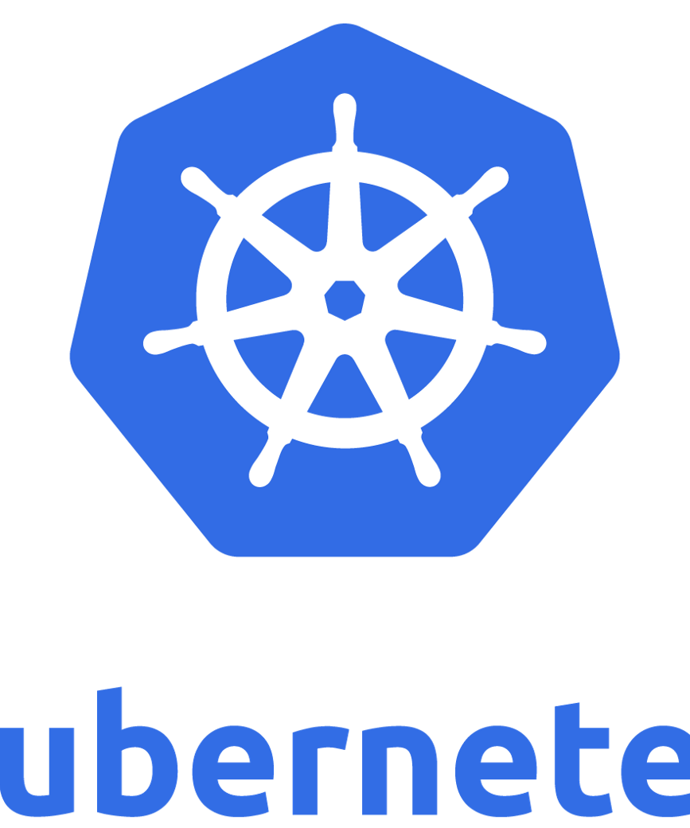
Possible improvements
Use Docker and Docker Swarm/Kubernet to scale out the endpoint service.
Change EF Core and use Dapper to connect on database (if using SQL Server)
Use Mongo DB (Cosmos DB API), as it does not use schema and it is pretty easy to change the document structure. In this case our system could be implemented in only one document (without the need to create relationships).

